Slide 1
Python RegEx

Slide 2
A RegEx, or Regular Expression, is a sequence of characters that forms a search pattern.
RegEx can be used to check if a string contains the specified search pattern.
Python has a built-in package called re, which can be used to work with Regular Expressions.
Import the re module:
import re

Slide 3
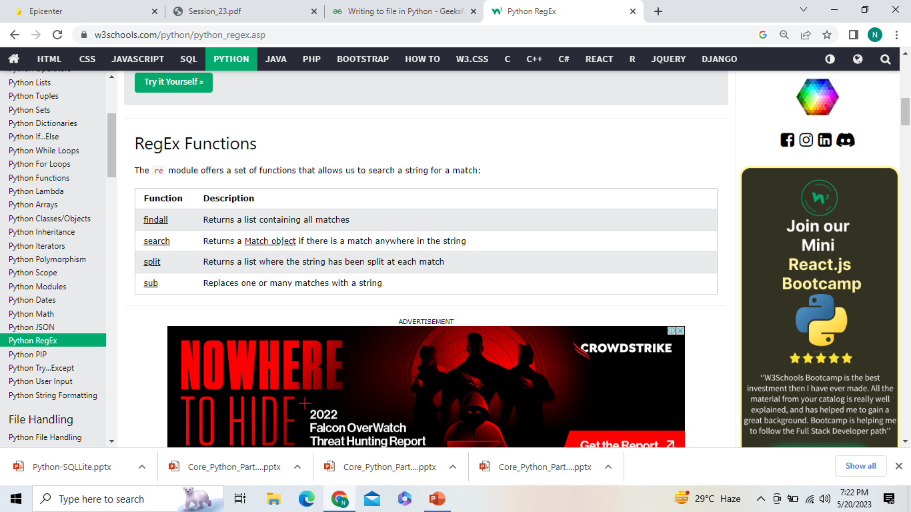

Slide 4
1)The findall() function returns a list containing all matches.
import re txt = "The rain in Spain" x = re.findall("ai", txt) print(x)
#Return an empty list if no match was found:import re txt = "The rain in Spain" x = re.findall("Portugal", txt) print(x)
2) Search for the first white-space character in the string:
import re txt = "The rain in Spain" x = re.search("\s", txt) print("The first white-space character is located in position:", x.start())
#If no matches are found, the value None is returned:
#Make a search that returns no match:
import re txt = "The rain in Spain" x = re.search("Portugal", txt) print(x)

Slide 5
A RegEx, or Regular Expression, is a sequence of characters that forms a search pattern. RegEx can be used to check if a string contains the specified search pattern.
Python has a built-in package called re, which can be used to work with Regular Expressions.
Import the re module:
import re
Search the string to see if it starts with "The" and ends with "Spain":
import re txt = "The rain in Spain" x = re.search("^The.*Spain$", txt)
x = re.search("The.*Spain", txt)
https://www.w3schools.com/python/python_regex.asp

Slide 6
3)The split() Function
Split at each white-space character:
import re txt = "The rain in Spain" x = re.split("\s", txt) print(x)
#You can control the number of occurrences by specifying the maxsplit parameter:
#Split the string only at the first occurrence:
import re txt = "The rain in Spain" x = re.split("\s", txt, 1) print(x)
4) The sub() Function
#Replace every white-space character with the number 9:
import re txt = "The rain in Spain" x = re.sub("\s", "9", txt) print(x)
#Replace the first 2 occurrences:
import re txt = "The rain in Spain" x = re.sub("\s", "9", txt, 2) print(x)

Slide 7
Match Object
#Do a search that will return a Match Object:
import re txt = "The rain in Spain" x = re.search("ai", txt) print(x) #this will print an object
The Match object has properties and methods used to retrieve information about the search, and the result:
.span() returns a tuple containing the start-, and end positions of the match. .string returns the string passed into the function
.group() returns the part of the string where there was a match
# The regular expression looks for any words that starts with an upper case "S":
import re txt = "The rain in Spain" x = re.search(r"\bS\w+", txt) print(x.span())
# Print the string passed into the function:
import re txt = "The rain in Spain" x = re.search(r"\bS\w+", txt) print(x.string)
#Print the part of the string where there was a match.
The regular expression looks for any words that starts with an upper case "S":
import re txt = "The rain in Spain" x = re.search(r"\bS\w+", txt) print(x.group())

Slide 8
https://www.w3schools.com/python/python_regex.asp#findall

Slide 9
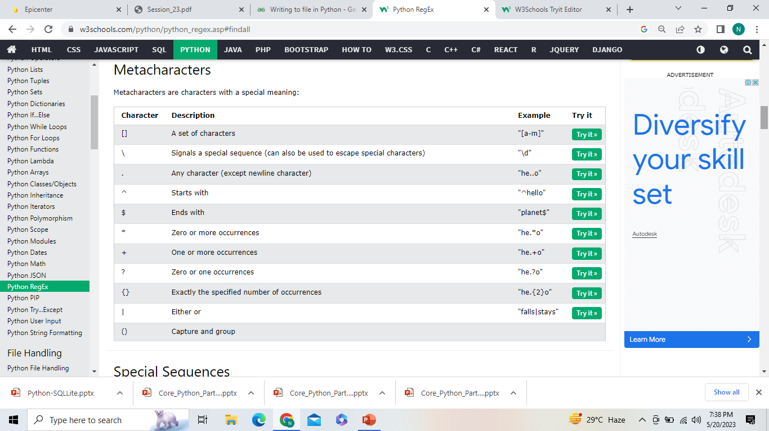

Slide 10
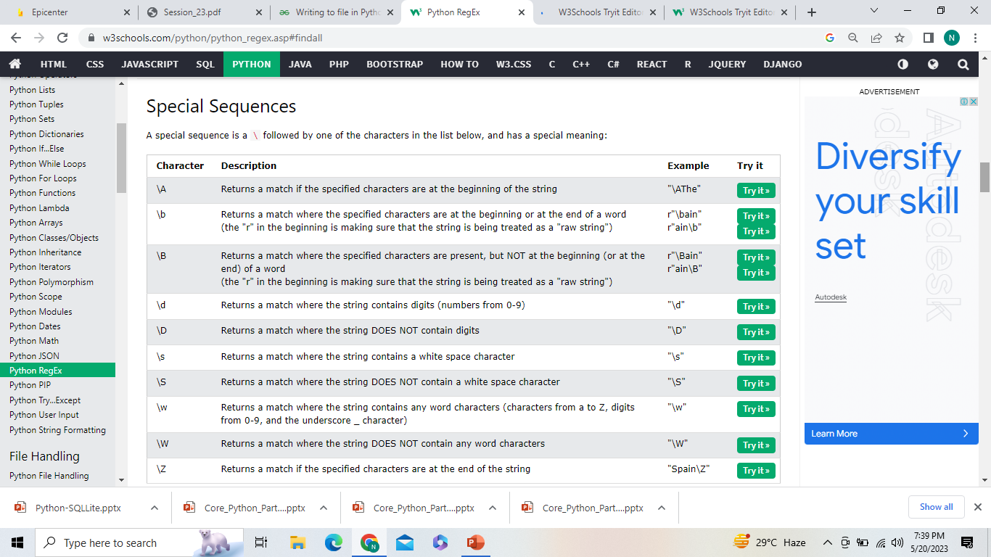

Slide 11
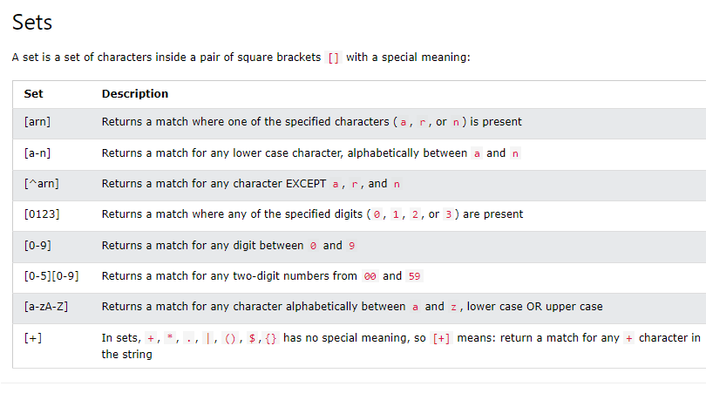

Slide 12
Exampels of Pattern matching in Python with Regex:
https://www.geeksforgeeks.org/pattern-matching-python-regex/

